Slide 1
IBAMR Tutorial - Boundary Conditions

Slide 2

Robin boundary conditions
Robin boundary conditions are a weighted combination of Dirichlet boundary conditions and Neumann boundary conditions.
If Ω is the domain on which the given equation is to be solved and ∂Ω denotes its boundary, the Robin boundary condition is:
for some non-zero constants a and b and a given function g defined on ∂Ω .

Slide 3

Example: Robin bc’s
In one dimension, if Ω = [0,1] , the Robin boundary condition becomes:
Notice the change of sign in front of the term involving a derivative. This is because the normal at x=0 points in the negative direction, while at x=1 it points in the positive direction.

Slide 4
Example cont’d
No slip boundary conditions (Dirichlet):
a=1, b=0, g = 0 => u(0)=0, u(1) = 0
Neumann boundary conditions:
a=0, b=-1,1, g = 0 =>
-u'(0)=0
u'(1)=0

Slide 5
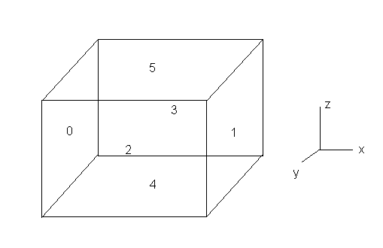
IBAMR boundary numbering
Look in the input2D/3D files.
2D: x_{left}=0, x_{right}=1, y_{bottom}=2, y_{top}=3
3D: add z_{bottom}=4, z_{top}=5

Slide 6
Choosing BC's in input2d
This would result in no slip (v=0) boundary conditions.
Note that VelocityBcCoefs_0 would set the x-component of velocity. The z-component would be 2.
VelocityBcCoefs_1 { // boundary conditions for the y-component of the velocity acoef_function_0 = "1.0"
acoef_function_1 = "1.0"
acoef_function_2 = "1.0"
acoef_function_3 = "1.0"
bcoef_function_0 = "0.0"
bcoef_function_1 = "0.0"
bcoef_function_2 = "0.0"
bcoef_function_3 = "0.0"
gcoef_function_0 = "0.0"
gcoef_function_1 = "0.0"
gcoef_function_2 = "0.0"
gcoef_function_3 = "0.0"}

Slide 7
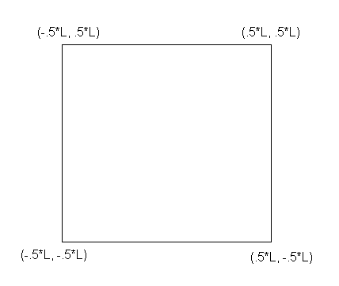
Domain size and periodic BC
Look at input2d.
x_lo sets x_{min} and y_{min}
x_up sets x_{max} and y_{max}
Periodic_dimension turns on periodic boundary conditions and overrides everything. Setting it equal to 1 means it’s on, and set to 0 is off.
CartesianGeometry {
domain_boxes = [ (0,0) , (N - 1,N - 1) ]
x_lo = -0.5*L, -0.5*L
// lower end of computational domain.
x_up = 0.5*L, 0.5*L
// upper end of computational domain.
periodic_dimension = 1, 1}

Slide 8
Example: Tethered Beam in Flow
In this example, a beam that is tethered in its center is placed in flow.
The flow is ramped from 0 to 0.1.
This is done by setting all boundary conditions equal U in the x-direction and 0 in the y-direction.
U is a function of time so that the flow accelerates from rest.
Look on github under examples
4-Example_2DTetheredBeam

Slide 9
Spatially and Time-Dependent Boundary Conditions
IBAMR is capable of time-dependent and spatially dependent boundary conditions.
In ‘input2d’: under VelocityBcCoefs_0(or 1) { //
In any of the coefficients, you can use the variable ‘t’ for any time-dependence
You can use X_0, X_1, or X_2 for x,y or z respectively.
You can use inline “if-statements” for specifying boundary conditions like “if x is less than 5, then u = 2, else u = 0”

Slide 10
Notes on in-line if-statements:
Notation: if( logical statement, a, b)
-if logical statement is true, do ‘a’
-if logical statement is false, do ‘b’
Note: Can used nested in-line if-statements as well, e.g.,
if (logical statement-1, a, if( logical-statement-2, b, c) )
[if logical-statement-1 is true, do ‘a’, else if logical-statement-2 is true, do ‘b’, else do ‘c’.]

Slide 11
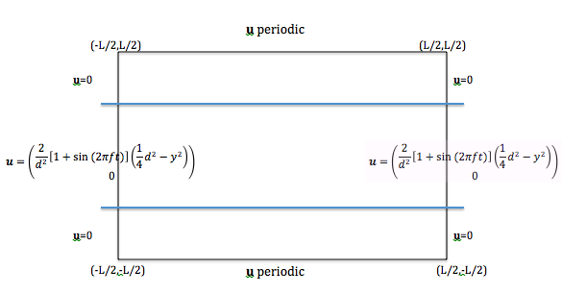
Example: Pulsatile Channel Flow
This example explores spatially and time-dependent boundary conditions for pulsatile flow through a channel.
We want to specify the boundary conditions as follows:

Slide 12
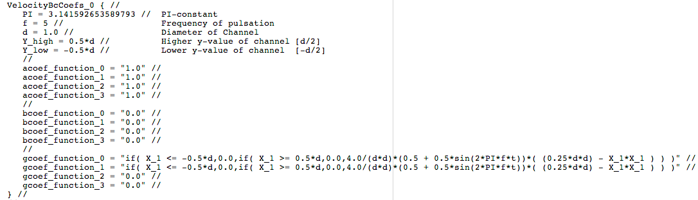
Example: Pulsatile Channel Flow
This is done by setting the appropriate x-component boundary condition on the right and left wall inside the ‘input2d’ file.
Look on github Examples under 4-Example_2DPulsatileChannelFlow

